Slide 1
Employee Data Analysis using Excel
STUDENT NAME: ANGEL D
REGISTER NO : 312216906
DEPARTMENT : B.COM (GENERAL)
COLLEGE : SHRI KRISHNASWAMY COLLEGE FOR WOMEN

Slide 2
PROJECT TITLE
Salary and Compensation Analysis
Through Excel Data Modelling

Slide 3


AGENDA
Problem Statement
Project Overview
End Users
Our Solution and Proposition
Dataset Description
Modelling Approach
Results and Discussion
Conclusion
3/21/2024 Annual Review

Slide 4

PROBLEM STATEMENT
The organization is facing challenges in ensuring fair and competitive compensation across various departments.
There is a need for an in-depth analysis of salary distribution, identification of any disparities, and recommendations for improvements to align with industry standards.

Slide 5

PROJECT OVERVIEW
This project aims to analyze the existing salary
and compensation data using Excel data modeling
techniques.
The goal is to develop insights that can help in
making data-driven decisions regarding salary
adjustments, promotions, and benefits allocation

Slide 6

WHO ARE THE END USERS?
Finance Team: To allocate budget efficiently and plan
for salary adjustments.
Employees: Indirectly, to ensure fair compensation
aligned with industry standards.
HR Department: To use the insights for refining
compensation policies. • Management: To ensure equitable and competitive
salary distribution.

Slide 7

OUR SOLUTION AND ITS VALUE PROPOSITION
Analyze current salary distributions
• Compare salaries against industry
benchmarks.
• Identify disparities across departments,
genders, and roles.
• Forecast the financial impact of
proposed salary adjustments
Value Proposition:
Enhanced Decision-Making:
Benefit: Enables more informed decisions by providing comprehensive and actionable insights into compensation practices and trends.
Increased Efficiency:
Benefit: Automates data management and reporting processes, saving time and reducing manual effort in compensation analysis.

Slide 8
Dataset Description
Purpose
This dataset is designed to analyze and model salary and compensation data across various dimensions, including job titles, departments, and locations. It aims to provide insights into compensation structures, identify trends, and support strategic decision-making.
Source
The data is sourced from the company's HR management system and payroll records, capturing detailed compensation information for all employees.
Data Characteristics
Format: Excel spreadsheet (.xlsx) or CSV (.csv). Granularity: Annual data for each employee. Time Period: Data covers the fiscal year 2023 (or specify the relevant period).

Slide 9

THE "WOW" IN OUR SOLUTION
Advanced Predictive Analytics
1. Feature: Utilizes sophisticated predictive models to forecast future compensation trends and budget impacts.
Benefit: Enables proactive adjustments to compensation strategies, helping organizations stay ahead of market changes and financial planning challenges.
2. Real-Time Interactive Dashboards
Feature: Provides dynamic dashboards with real-time data visualization and interactive elements like slicers and filters.
Benefit: Offers instant insights and allows users to explore data from multiple perspectives, enhancing decision-making speed and flexibility.
3. Comprehensive Data Integration
Feature: Seamlessly integrates data from various sources, including payroll systems, HR databases, and external market benchmarks.
Benefit: Delivers a holistic view of compensation practices and trends, ensuring that analysis is based on complete and up-to-date information.
4. Customizable Scenario Analysis
Feature: Allows users to create and test multiple compensation scenarios based on different variables (e.g., economic conditions, policy changes).
Benefit: Supports strategic planning by evaluating potential outcomes under various conditions, helping to identify the best compensation strategies.
3/21/2024 Annual Review
9

Slide 10
MODELLING
Descriptive Modelling : Pivot Tables: Summarize data to show averages, totals, and distributions across various dimensions (e.g., average salary by department). Charts: Create bar charts, histograms, or pie charts to visualize salary distributions and comparisons.
Predictive Modelling Regression Analysis: Linear Regression: Use to predict future salaries based on variables such as years of experience or education level. Utilize Excel’s LINEST function or Data Analysis Toolpak. Multiple Regression: Analyze the impact of multiple variables on salary simultaneously. Trend Analysis: Time Series Analysis: Examine trends over time to forecast future compensation. Use Excel functions like FORECAST.ETS for seasonal data.
10

Slide 11
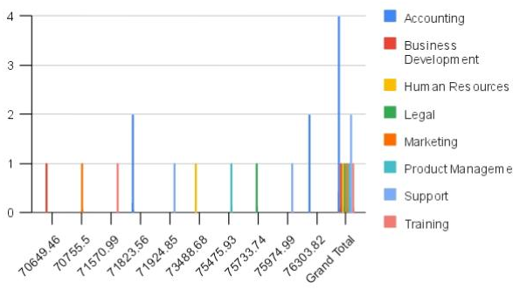
RESULTS
11

Slide 12
conclusion
Improved Transparency and Reporting :
Visualizations: Interactive dashboards and clear visualizations simplify data interpretation, making it easier to communicate findings and recommendations to stakeholders.
Benchmarking: Comparative analysis against industry standards provides context and helps ensure competitive compensation practices Strategic Compensation Planning
Optimization Opportunities: Insights from modelling help identify areas for optimization, ensuring compensation aligns with market rates and organizational goals Enhanced Understanding of Compensation Structures Comprehensive View: Descriptive analysis offers a detailed understanding of salary distributions, departmental differences, and the impact of benefits. Trend Analysis: Predictive modelling reveals compensation trends, helping organizations anticipate future salary needs and market changes
Final Thoughts Effective use of Excel for salary and compensation modelling equips organizations with the tools to make informed, data-driven decisions. By leveraging predictive analytics, scenario planning, and detailed visualizations, organizations can align their compensation practices with strategic goals, manage budgets more effectively, and stay competitive in the market

